Slide 1
Flappy Bird Bot
Junhao Wang
Luqi Ye

Slide 2
Introduction
Linear Support Vector Classifier for Flappy Bird Game
Various Fits in Support Vector Classifier
Different Choice of Parameters

Slide 3
Support Vector Classifier
Choice of features and output
X,Y-coordinate of the bird and the pipes, horizontal and vertical velocities of the bird
No significant result leaded to shift to e differences in the x and y coordinates ∆x and ∆y
Output is a boolean “tapped” which is 0 or 1, signifying that the bird has flapped or not

Slide 4
Degree of Polynomial
Finalizing Degree of Polynomial depended on factors like:
Training training data set size
Computational limitations
Overfitting due to large polynomial size
After comparing various degrees, second and third degree polynomial fit gives better results. Chosen third degree polynomial fit as the final fit

Slide 5
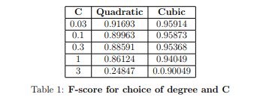
Choice of hyperparameter
Testing on 5 different choices of C, [0.03, 0.1, 0.3, 1, 3] on both polynomials of degree 2 and 3.
Training dataset: 5 million, cross-validation dataset: 1 million
Data set highly skewed (1 in 100 positive examples)
Calculation of micro F-score metric Table:

Slide 6
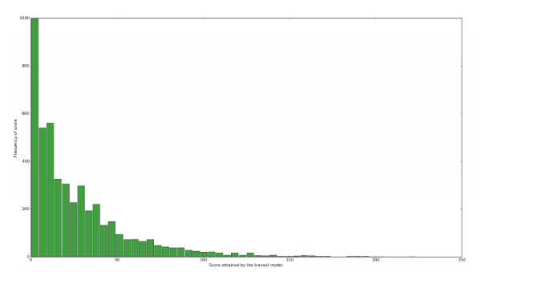
Scores
Collected 4700 scores from the SVC trained with a cubic fit and C = 0.03 on a training set of approx 65 million points. Mean: 26.4295 Standard deviation:28.9981 Max: 223 Min: 0 Histogram: Frequency of score VS Score obtained

Slide 7
Conclusion and Further Implementation
From the histogram, we noted down performance of SVC model which will later be used to compare with neural network
Moving ahead we will be using a neural network with different choice of activation units and different architectures and also Q-learning methods to make our bots

